Slide 1
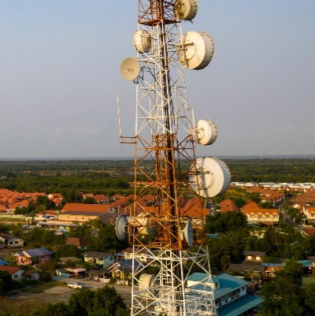
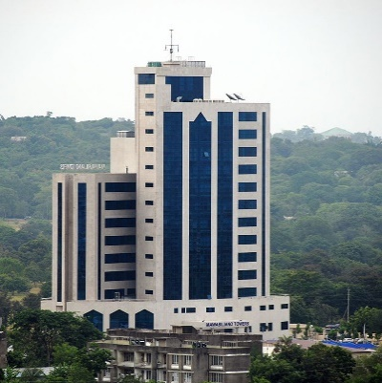
THE UNITED REPUBLIC OF TANZANIA
TANZANIA COMMUNICATIONS REGULATORY AUTHORITY
Knowledge Sharing on the Implementation of the Extended Producer Responsibilities, A Tanzanian Perspective
Presented by:-
Sadath Kalolo,
Manager, Telecom and Internet Services
Tanzania Communications Regulatory Authority

Slide 2
Outlines
Context
The legal and regulatory framework
The Extended Producer Responsibilities
Stakeholders Roles
E-Waste Management Challenges
Key Steps to take

Slide 3
Context
The telecommunication subscriptions continue to grow rapidly in the country;
As of December 2022, the total active SIM cards reached 60,192,331 marking the telecommunication penetrations to reach 98%;
The sector growth and the digital transformations forms the basis for the increase in usage of electronic communication equipment;
Emerging technologies such as Internet of Things and 5G are promising for more usage of ICT equipment in the country

Slide 4
CONTEXT…
The growth of the communication sector comes with environmental and health costs due to increases in amount of electronic waste generated;
The amount of electric and electronic equipment put in the market in Tanzania mainland has increased from 21,692 tonnes in 1998 to 47,504 tonnes in 2017. E-waste generated has increased from about 2000 tonnes in 1998 to 35,755 tonnes in 2017 (The National E-Waste Statistics Report, 2019);
Thus, it is necessary to continue improving our frameworks for managing electronic wastes including the use of extended producer responsibilities;

Slide 5
Legal and Regulatory Frameworks
The Electronic and Postal Communications Act through the miscellaneous amendment of 2019 gave obligations to the Tanzania Communications Regulatory Authority to manage electronic communication equipment end of life processes;
The Electronic and Postal Communications (Electronic Communication Equipment Standards and Electronic Waste Management) Regulations of 2020 provides obligations of different stakeholders including the control of Importation of Electronic Communication Equipment and Payment of Advance Eco Levy fees to mobilize resources for establishment of sound electronic waste treatment facilities;
The Environmental Management (Control and Management of Electrical and Electronic Equipment Waste) Regulations of 2021 provides for proper management of electronic wastes to protect human health and the environment as well as providing a framework for licensing different stakeholders such as e-waste collectors, transporters, recyclers and refurbishes;

Slide 6
Extended Producer Responsibilities
The Electronic and Postal Communications (Electronic Communications Equipment Standards and E-Waste Management) Regulations of 2020 provides the obligations for Importers and Manufacturers of electronic communications equipment in the country;
Manufacturers and importers will:-
Pay advance eco levy fees for each electronic communication equipment that is introduced in the market in respect of the management of the end of life processes of such equipment;
Establish take back schemes including channels for collection of electronic wastes;
Promote use of safer components in manufacturing their products, avoid importing electronic communication equipment containing hazardous materials and provide information to recyclers on dismantling their products;
Have formal agreement with licensed recyclers, refurbishers or electronic waste treatment facilities;
Advance Eco levy fees will be used for establishing electronic waste treatment facilities and incentivising take back schemes as well as collection of electronic wastes;

Slide 7
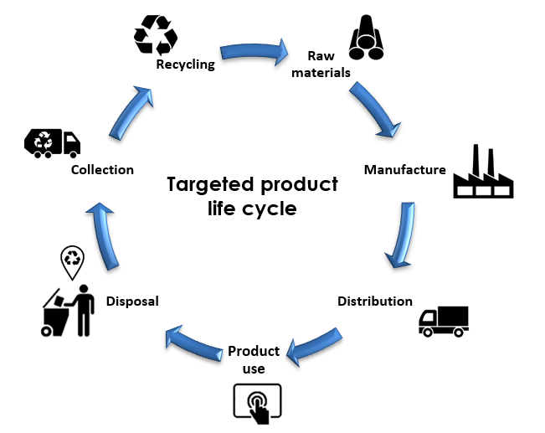
Extended Producer Responsibilities…
Different stakeholders are involved in the value chain from distributors of electronic communication equipment, consumers/bulk consumers, licensed collectors to recyclers;
Imported electronic communications equipment are subjected to inspections to verify compliance to type approval requirement and limits on hazardous substances;
Importation of used electronic communication equipment that are approaching their end of life is controlled in accordance with the requirement of the Basel Convention;

Slide 8
Stakeholders’ Roles
In cognizant that electronic waste management is a multi-stakeholder process, the implementation of the extended producer responsibilities is engaging different stakeholders including the tax Authorities, Environmental Management Authorities, the Ministry responsible for communications, Ministry responsible for the environment, local government Authorities, licensed collectors, recyclers, consumers, bulk consumers etc.;
TCRA engaged an External Service Provider M/s Bureau Veritas Tanzania Limited for the Pre-Inspection of electronic communication equipment at the country of export and collection of advance eco levy fees;
The pre-inspection of electronic communication equipment and the collection of advance eco levy fees are supported by an online platform through which all applications for importations and payments are made;
Stakeholders are working together based on their mandates and will have access to the online platform to track the processes;

Slide 9
E-Waste Management Challenges
Existing gaps in the legal and regulatory frameworks due to the rapid growth of the sector and changes in technologies, Thus, the need for frequent reviews on existing frameworks;
Technology availability and technology transfer. As there are no full fledged electronic waste treatment facilities, some of the collected electronic waste have to be exported abroad which adds more costs in the management processes;
Uncertainty in the sustainability of the electronic waste management lifecycle due to illegal importation and illegal waste disposals;
Lack of knowledge and skills on electronic waste management;

Slide 10
Key Steps to take
Coordination among environmental & ICT experts is required for efficiency and sustainable management of electronic waste in the country;
Continue to work on preventive policies to avoid electronic waste effects as well as learning on international initiatives such as the works ITU-T Study Group 5;
Establish initiatives for effective project implementation and strengthen electronic waste sustainable management alliances.
Promote initiatives and investments to develop the necessary infrastructure for electronic waste management;

Slide 11
Key Steps to take…
Define new policies to promote recycling and reuse of electric and electronic equipment and prevent illegal importations;
Engage into impactful public awareness and consumer education regarding management of electronic waste to get support of all stakeholders;
Develop synergies between existing initiatives to avoid duplication and optimize the use of available resources;
To promote innovation and technology transfer to increase technology availability for the efficient management of electronic waste;

Slide 12
Key steps to take…
We all have a role to play by working together and continue improving our electronic waste management systems throughout the entire chain comprising of electronic waste generation, collection, storage, transport, recycling and disposal processes.

Slide 13
CONTACT US
ADDRESS:
Mawasiliano Towers, Sam Nujoma Rd
WEBSITE:
https://www.tcra.go.tz/
EMAIL:
barua@tcra.go.tz
TELEPHONE:
+255 22 2412009 - 10

